Slide 1
HHSC Employment Recruitment Coordinator (ERC) Activities
Monty Chamberlain
Employment Recruitment Coordinator

Slide 2
Money Follows the Person (MFP) Employment Initiatives Project
In concert with other employment initiatives, DADS (now HHSC) determined the need for Employment Recruitment Coordinator (ERC) activities (project began January, 2015);
Development of materials, video, and initial website work in 2015;
Information Letter 15-72, November 16, 2015 introducing role;
Field based work statewide to reach beyond a state office based approach with a direct face to face representative;
Ultimate goal is to increase employer awareness of the population we serve and increase integrated employment opportunities.

Slide 3

Goals for the role of the Employment Recruitment Coordinator
Pursue employment opportunities in support of individuals who set integrated employment as a goal;
Establish ongoing relationships with businesses / employers;
Network and establish community and civic organization relationships;
Promote Employment First principles.

Slide 4

MFP Employment Initiatives Project
The Big Goal:
Market to employers why employing persons with disabilities is a good business decision!

Slide 5
A Focus on a Person’s Ability as Opposed to Disability
Individuals who desire to work in integrated employment bring value to the workplace as a productive member of the organization;
Out of the box thinking with the ability to meet the employers need with difficult to fill or high turnover positions;
Dedicated with excellent attendance records, low turnover, and on-time!

Slide 6
How is the message being delivered?
Direct interaction with employers in face to face settings
  Presentations
  Informal discussions
  Cold calls
Presentations at Chamber and Rotary meetings;
Networking and expansion of employers (new participants and those already employing persons with disabilities);
Networking with various TWC–VRS Rehab staff;
Job Fairs;
ERC works throughout the state as a front line representative to educate employers and pursue a commitment from employers.

Slide 7

Partnership with Local Authorities (Talent Agents and the Talent)
Develop the initial contact with a potential employer as a result of presentation in larger setting;
Initiate dialogue with potential employers to ascertain the type of business and brainstorm potential opportunities (thinking out of the box);
Connect potential employer with the appropriate Local Authority point person (talent agent) for development of business relationship locally.
Local Authority point person is contact for direct talent and talent from Private Providers.

Slide 8
Difference between the ERC and TWC – VRS Field Staff
ERC focus is a more global focus with employers as opposed to individual employment cases;
Focus is more statewide as opposed to local;
Open doors with employers that have a statewide presence with intent of establishing large scale initiatives;
Work in concert with TWC–VRS Rehab staff on mutually beneficial projects such as job fairs and encourage provider attendance.

Slide 9
Tools to Communicate
Packet of Information to remain with employers;
Handbill / Postcard selling employer benefits for hiring;
Better Bottom Line document;
Power Point employer focused presentation;
Employer Acknowledgement Form;
Employer list on HHSC website;
TWC “Guide for Hiring People with Disabilities”;
DADS Employment Marketing video.
Provide employer contacts to LIDDA’s and Service Providers

Slide 10

Publicity Consent Form

Slide 11

Employment Web Page Sample

Slide 12
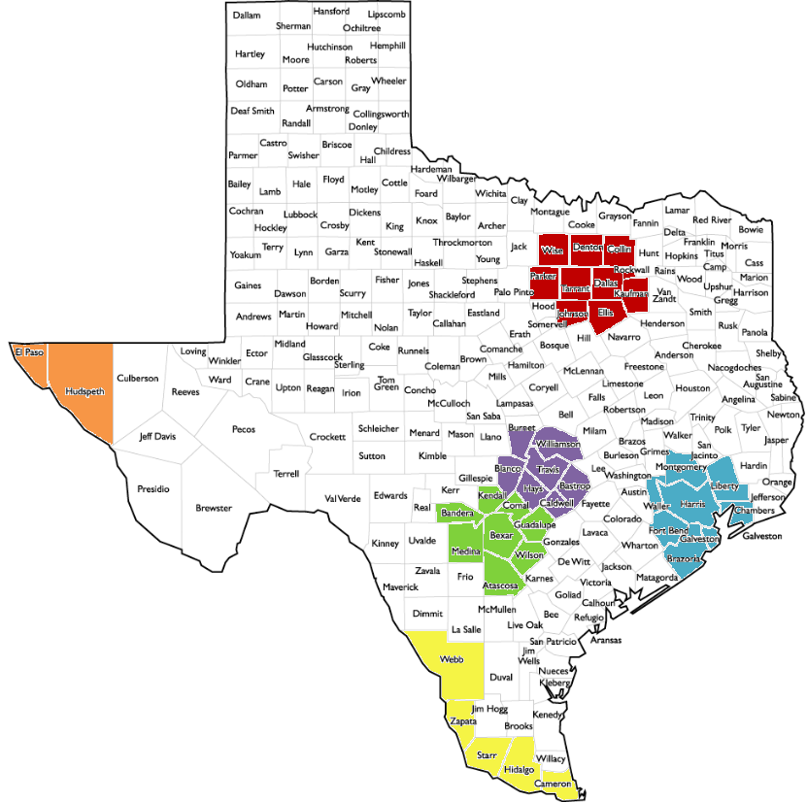
State Population
 | Dallas / Ft Worth | 25.1%
 | Houston | 23.7%
 | San Antonio | 8.6%
 | Austin | 7.3%
 | Valley | 6.1%
 | El Paso | 3.2%

Slide 13

What is the Ultimate Goal?
Convince employers that employing persons with disabilities is a good business decision!

Slide 14
Employment Recruitment Coordinator Contact Information
Monty Chamberlain
701 W. 51st Street
Austin, Texas 78751
Mail Code: W-580
512-971-8839
monty.chamberlain@HHSC.state.tx.us and erc@hhsc.state.tx.us
Video Link: https://hhs.texas.gov/services/disability/employment/employment-first or EmploymentVideo

Slide 15

This Training was Funded by a Centers for Medicare and Medicaid Services Money Follows the Person grant

