Slide 1
Data, Reporting, and Funding
ECI Advisory Committee Orientation for new members
Notes:
This module of the ECI Advisory Committee Orientation covers basic information about how data and reporting is used to monitor our contractors’ quality of service delivery, and sources of funding.

Slide 2
Reporting Requirements
Annual Performance Report (APR)
ECI is responsible for administration of the Texas Part C system of the Individuals with Disabilities Education Act (IDEA)
The APR is submitted to the U.S. Department of Education, Office of Special Education Programs annually
The APR is reviewed and approved by the ECI Advisory Committee
Visit the U.S. Department of Education, Office of Special Education Programs (OSEP) website to review the current APR reports
Notes:
As one of its responsibilities in administrating the Texas Part C system of the Individuals with Disabilities Education Act (IDEA), ECI develops the Part C Annual Performance Report every year with input from you, the ECI Advisory Committee. The APR is an annual report submitted to the U.S. Department of Education, Office of Special Education Programs (OSEP).
The APR includes data and improvement activities for 11 indicators and requires states to report on compliance indicators such as:
timelines for service planning,
service delivery hours,
and transition when the child is 3 years of age (36 months).
The indicators are divided into in four categories:
Services in Natural Environments
Child Find
Transition
General Supervision System
The ECI Advisory Committee is responsible for approving the ECI Annual Performance Report. Once the report is approved and finalized, a copy is also submitted to the Governor of Texas. Visit the OSEP website to review the current APR report.

Slide 3
ECI Data
Texas Kids Intervention Data System (TKIDS)
TKIDS is the ECI information and reporting system.
TKIDS information is used to:
Help plan, monitor and budget for services
Assist local programs in managing their ECI programs
Identify programmatic areas in need of improvement
Fulfill state and federal government reporting requirements
Notes:
The Texas Kids Intervention Data System (TKIDS) is a system containing case information for children who have been referred to and/or enrolled in ECI services. This system provides data for reports run by individual programs or the state office to evaluate program or staff performance, quality of services, and compliance. TKIDS is an automated system developed to collect information on children’s progress through the early intervention service system and to record the types of services provided to children and their families.
TKIDS information is used to:
help ECI plan, monitor and budget for services;
assist local contractors in managing their ECI programs;
identify statewide systemic programmatic areas in need of improvement; and
fulfill state and federal government reporting requirements.

Slide 4
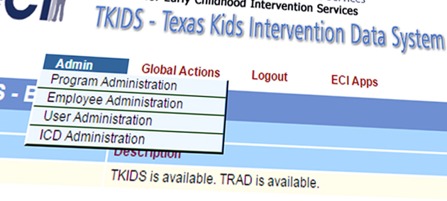
ECI Data
Types of information captured in TKIDS
Administrative Data
Program Data
Employee Data
Child Data
Notes:
TKIDS captures various types of information related to administrative and child data entered by the ECI programs.
The administrative data section collects:
Program data (agency name, program code, and contact information for the program director)
Employee data (individual employee information within an ECI agency including demographic information, hire date, and termination date)
User data (only viewable by ECI State Office to give different levels of access to user databases)
The reports pulled from here are typically used by Performance and Oversight to monitor the number of staff and types of staff credentials.
The child data section includes:
Child-level information. All valid referrals must be entered into TKIDS. Valid referrals include all written, phone and face-to-face referrals that the program receives from any source.
Information on inappropriate referrals; for example, children three years of age and older not captured in TKIDS.
Reports generated from the child data include, but are not limited to the following:
number of children enrolled in ECI,
number of hours of services being provided,
how children are qualifying for ECI services,
global child outcomes, and
if federal timelines are being met.
Ultimately, all data entered by ECI programs is utilized for reporting requirements of federal indicators and Texas legislators.

Slide 5
State Systemic Improvement Plan (SSIP)
Multi-year, achievable plan that:
Increases capacity of ECI to implement, scale up, and sustain evidence-based practices
Improves outcomes for children with disabilities and their families
2018
2017
2016
2015
August 2014
Notes:
In 2014, the U.S. Department of Education, Office of Special Education Programs (OSEP) instituted a new APR indicator, the Statewide Systemic Improvement Plan or “SSIP,” whose focus is on quality over compliance.
The SSIP is a multi-year plan that:
Increases the capacity of ECI to implement, scale up, and sustain evidence-based practices
Improves outcomes for children with disabilities and their families.
Is implemented over three phases.
ECI welcomes this opportunity because both OSEP and ECI want to enhance the system from one that is focused mostly on compliance to one that also emphasizes quality results. While contractor activities, like timely data reporting, are important, we all know that progress in a child’s development is most important to the families we serve. The SSIP project therefore brings what is most important to the forefront of our work over the next few years.

Slide 6
SSIP Activities by Phase
Year 1 - FFY 2013 data Delivered by April 2015 | Year 2 - FFY 2014 data Delivered by April 2016 | Years 3-6 FFY 2015-18 data Delivered by April 2017- April 2020
Phase I Analysis | Phase II Plan | Phase III Implementation and Evaluation
Data analysis: Identification of the focus for improvement Description of infrastructure to support improvement and build capacity Theory of action | Multi-year plan addressing: Infrastructure development Support for ECI program in implementing evidence-based practices Evaluation plan | Reporting on progress including: Results of ongoing evaluation Extent of progress Revisions to the SPP
Notes:
The proposed SSIP is to be developed in two phases and then implemented and evaluated in a third phase. These phases cover the new APR reporting period of 2015-2020.
Phase I—FFY 2013 due to OSEP in April 2015
Phase II—FFY 2014 due to OSEP in April 2016
Phase III—FFY 2015 due to OSEP in April 2017 through April 2020
Phase I includes a Pre-report:
Data analysis
Identification of the focus for improvement
Description of infrastructure to support improvement and build capacity
Theory of action
Phase II includes development of the multi-year plan:
Infrastructure development
Supports for EI programs in implementing evidence-based practices
Evaluation plan
Phase III includes an evaluation and implementation of the plan and reporting of progress:
Results of the ongoing evaluation
Extent of progress
Revisions to the plan

Slide 7
Where are we now?
SiMR:
Texas Part C will substantially increase the rate of growth in infants and toddlers demonstrating positive social-emotional skills by 0.2% each year resulting in overall increase of 0.8% by the final year (FFY 2018).
Notes:
Each state identified a State Identified Measurable Result (SiMR), which is the state’s desired result of the SSIP. In Texas, our SiMR is that Texas Part C will substantially increase the rate of growth in infants and toddlers demonstrating positive social-emotional skills by 0.2% each year resulting in overall increase of 0.8% by the final year (FFY 2018).

Slide 8
SSIP Strategies
First strategy group:
Ensure staff consistently use the identified evidence-based practices when providing ECI services. Ensure staff is able to identify social-emotional concerns and provide appropriate and effective intervention to address these concerns.
Notes:
The first group of strategies, which is aimed at the provision of ECI services, focuses on improving the accuracy of child outcome ratings, the consistent use of an evidence-based practice (coaching) with fidelity, and targeted technical assistance and quality assurance efforts from the state office.

Slide 9
SSIP Strategies
Second strategy group:
Increase families’ knowledge about their role in supporting their child’s development, including their social-emotional development.
Notes:
The second group of strategies is focused on increasing families’ knowledge about their role in supporting their child’s development. This will include an emphasis on the parent-child relationship, teaching families about their children’s development and how to enhance development within their daily routines, and how enhancing social-emotional development improves other areas of development.

Slide 10
SSIP Strategies
Third strategy group:
Inform primary referral sources, parents and other early intervention providers about the importance of social and emotional development in young children within the context of the parent/child relationship, and its foundational role in development across all domains.
Notes:
The third group of strategies focuses on improving public outreach to the community in order to help referral sources learn more about the role of social-emotional development in the child’s overall development and how ECI services focus on the parent-child relationship to improve social-emotional outcomes.
As you may have noted, the SSIP builds upon the knowledge base and services already being provided by ECI programs to improve outcomes for children and families.

Slide 11
Who is key for this plan?
ECI Advisory Committee
Critical participants in improving outcomes for children with disabilities and their families.
How can you help?
Provide feedback and assist with stakeholder involvement
Implementation of activities will begin FY 2016-FY 2018
Continuous monitoring of performance
Revise and establish state targets.
Notes:
Who is key for this plan? The ECI Advisory Committee. You are critical participants in providing guidance on improving outcomes for children with disabilities and their families.
How can you help? Provide feedback and assist with stakeholder involvement in your community and professionally. Help with oversight of implementation activities that begin in Fiscal Year 2016-2018. This plan requires continuous performance evaluation and establishment and revision to state targets. You will learn more about the development of the SSIP at future ECI meetings. We hope you will volunteer to help with this new effort.

Slide 12
Funding Sources
Notes:
(NO AUDIO)

Slide 13
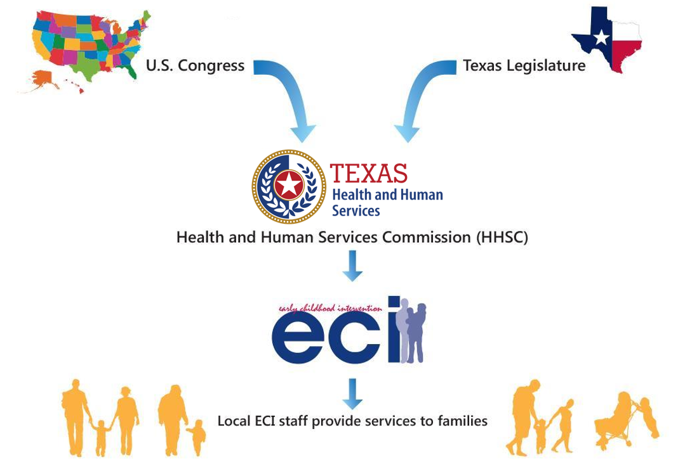
Legislation for ECI Services
Notes:
In ECI, we receive mandates and funds from both the federal and state level. Laws from the federal level come from IDEA (Individuals with Disabilities Education Act), which is the law ensuring services for children with disabilities, birth through 21, throughout the nation. There are two parts: Part B provides services 3-21 and Part C provides services from birth until the child’s third birthday. These rules and regulations are located in the Code of Federal Regulations (CFR). ECI also receives other federal funding from TANF (Temporary Assistance for Needy Families), TCM (Targeted Case Management Services), SST (Specialized Skills Training), and MAC (Medicaid Administrative Claiming).
The Texas ECI State Office creates rules specific to our state, which can be found in the Texas Administrative Code (TAC). We are part of the Health and Human Services System in the Health, Developmental, and Independence Services Division In addition to our leadership , there are three sections in the ECI program, these include; Program Evaluation, Analysis, and Reporting (or PEAR); Performance and Oversight; and Policy and Support. Our services are contracted out to local agencies so ECI programs cover every county in Texas.

Slide 14
ECI Funding Sources
Local ECI Contractors
Federal & State Funding
Third Party Payors
(Medicaid MCOs, CHIP MCOs, Private Ins., TMHP, TRICARE)
Family Payments
Local City and County Funding
Notes:
Local ECI contractors are reimbursed for services through various funding sources that include:
federal and state funds
local city and county funding
family payments, and
reimbursements from third party payors.

Slide 15
ECI Funding
Federal Requirements for ECI Services
Local ECI contractors are required to comply with federal regulations including those related to third-party billing.
Federal regulation prohibits the use of federal and state funds for services that would otherwise be paid from another public or private source.
ECI is the payor of last resort.
Therefore, if a child is eligible for other funding sources, ECI contractors are required to bill those funding sources first before billing for services using ECI contract funds.
Notes:
Federal regulations for early intervention Part C programs, Code of Federal Regulation (CFR) Title 34, Part 303, §303.510, prohibit the use of federal and state funds for services that would otherwise be paid from another public or private source.
ECI is the payor of last resort. Therefore, if a child is eligible for other funding sources, ECI contractors are required to bill those funding sources first before billing for services using ECI contract funds.

Slide 16
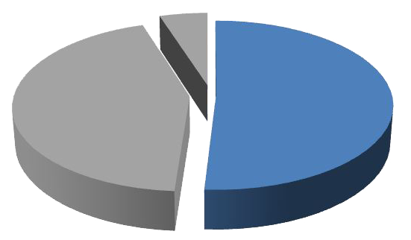
ECI Funding Sources
Private and public insurance
(51% of contractor funding, FY 2014)
Private Insurance
TRICARE
Children's Health Insurance Program (CHIP)
Medicaid
Family Out of Pocket Payments
Notes:
Let’s learn about the various sources of funds for contractors.
51% of contractor funds come from the following 5 sources:
Private Insurance
TRICARE
Children's Health Insurance Program (CHIP)
Medicaid and
Family Out of Pocket Payments
There are various private health insurance plans. Some of the most common are fully insured employer contracts with insurance companies: employer self-funded or self-insured group policies, and individual or family policies purchased directly from insurance companies. The amount of insurance coverage depends on what was purchased by the employer or family and can change periodically.
TRICARE is the U.S. Department of Defense health care entitlement program for active duty, Guard and Reserve and retired members of the military, and their eligible family members and survivors. Reimbursement is based on fee-for-service and only reimburses for physical and behavioral health services.
Children’s Health Insurance Program (CHIP) is a health insurance program designed for children whose families do not qualify for Medicaid and cannot afford private health insurance. To qualify, the child must be under age 19, a Texas resident, and a U.S. citizen or legal permanent resident. Coverage is for 12 months and families must re-apply after that time. Most physical and behavioral health services are reimbursed by CHIP MCOs contracted through HHSC.

Slide 17
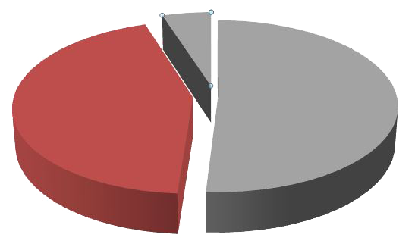
ECI Funding Sources
HHSC appropriations via contract
(44% of contractor funding, FY 2014)
IDEA Part C
IDEA Part B
Temporary Assistance for Needy Families (TANF)
Foundation School Funds
Notes:
The second funding source contractors receive is from HHSC appropriations via their contract, for a total of 44% of funding.
These funds are received from:
IDEA Part C,
IDEA Part B,
Temporary Assistance for Needy Families (TANF), and
Foundation School Funds

Slide 18
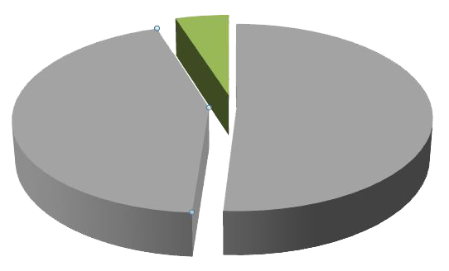
ECI Funding Sources
Local agency earned or collected funds
(5% of contractor funding, FY 2014)
Cash and in-kind donations
City and county fees
United Way contributions
Fundraisers
Foundations
Notes:
Lastly, ECI contractors received local funding for a total of 5% of funding via cash and in-kind donations, city and county fees, United Way contributions, fundraisers, and foundations.

Slide 19
Contractors’ Responsibilities
ECI contractors are required to:
Become an enrolled provider to provide direct services and bill services to third-party payors
Establish third-party billing systems
Verify child’s eligibility with third-party payors
Complete and submit claims to third-party payors
Know third-party payors’ pre-requisites for reimbursement
Notes:
ECI contractors are required to:
Obtain a National Provider Identifier (NPI) and Texas Provider Identifier (TPI) to provide direct services and bill services to third-party payors.
Make a good faith effort to enroll as a provider with private insurance companies serving ECI families in their local service area.
Establish systems and develop processes for billing for ECI services to third parties.
Always verify a child’s third-party benefits before submitting claims for reimbursement for services provided.
Understand the specific payor’s requirements for submitting claims. These requirements are normally listed in the provider manuals and may also be included in the provider agreement.

Slide 20
Contractors’ Responsibilities
ECI contractors are required to:
Obtain prior written parental consent before:
releasing personally identifiable information to any third-party payor or
billing private insurance.
Make sure claims:
accurately reflect services provided, supported by documentation, and
include correct billing information and billing codes.
Maintain claims documentation in the child’s record.
Notes:
The ECI contractor must always obtain written parental consent before releasing personally identifiable information to any third party-payor or billing private insurance.
Make sure:
Billing codes are correct on the claim form and claims accurately reflect the services provided to receive reimbursement and there is documentation to support delivery of services.
Documentation and records must be accurate to support the services billed. Documentation must also be in the child’s record or available for auditing purposes.

Slide 21
Questions?
Contact:
ECI Advisory Committee Outreach Specialist listed in your manual
ECI state office: 512-424-6754
Notes:
If you have any questions, please contact the ECI Advisory Committee Outreach Specialist listed in your Advisory Committee member manual section 4 under the Policy and Support Section. You may also contact the ECI State office at 512-424-6754.
The last item in this series of modules for Advisory Committee Orientation is a collection of resources for you to learn more about ECI.

