Slide 1
ECI Advisory Committee
Orientation for new members
Notes:
Welcome to the ECI Advisory Committee Orientation. This presentation covers basic information about the ECI program and some specific information you’ll need to know as an Advisory Committee member. Additionally, you’ll learn about the rules and regulations that govern ECI’s unique way of service delivery, how data and reporting is used to monitor our contractors’ quality of service delivery, and how ECI services are funded through federal and state resources.
This orientation is separated into five modules:
Advisory Committee Information
Legislation, rules, and history
ECI services
Data, reporting, and funding sources
Other resources

Slide 2
The Basics of ECI
Notes:
Early Childhood Intervention Services (ECI) contracts with statewide local programs which provide services and supports to families with children from birth to 36 months of age who have developmental delays, or who have a qualifying medical diagnosis with a need for early intervention services. Early intervention involves assisting families by promoting the acquisition and use of skills to enable children to participate meaningfully with others and within their natural environment.

Slide 3
ECI’s Seven Key Principles*
* Workgroup on Principles and Practices in Natural Environments, OSEP TA Community of Practice: Part C Settings. (2008, March). Agreed upon mission and key principles for providing early intervention services in natural environments. Retrieved from http://ectacenter.org/~pdfs/topics/families/Finalmissionandprinciples3_11_08.pdf
Infants and toddlers learn best through everyday experiences and interactions with familiar people in familiar contexts.
All families, with the necessary supports and resources, can enhance their children’s learning and development.
The primary roles of a service provider in early intervention is to work with and support family members and caregivers in children’s lives.
The early intervention process, from initial contacts through transition, must be dynamic and individualized to reflect the child’s and family members’ preferences, learning styles, and cultural beliefs.
Notes:
These are the Seven Key Principles upon which ECI’s foundation is built. The Seven Key Principles for providing early intervention services in natural environments were developed by the national Principles and Practices In Natural Environments Workgroup. This workgroup of subject matter experts and researchers in early intervention agreed that the seven key principles are the foundations that support the mission of early intervention, which is to build upon and provide supports and resources to assist family members and caregivers to enhance children’s learning and development through everyday learning opportunities.

Slide 4
ECI’s Seven Key Principles*
* Workgroup on Principles and Practices in Natural Environments, OSEP TA Community of Practice: Part C Settings. (2008, March). Agreed upon mission and key principles for providing early intervention services in natural environments. Retrieved from http://ectacenter.org/~pdfs/topics/families/Finalmissionandprinciples3_11_08.pdf
Individualized Family Service Plan (IFSP) outcomes must be functional and based on children's’ and families’ needs and family-identified priorities.
The family's priorities, needs, and interests are addressed most appropriately by a primary provider who represents and receives team and community support.
Interventions with young children and family members must be based on explicit principles, validated practices, best available research, and relevant laws and regulations.
Notes:
(NO AUDIO)

Slide 5
Advisory Committee
Responsibilities of Advisory Committee Members
Notes:
In this section, you will learn the responsibilities of committee members and what to expect at meetings. You will also learn who else is on the committee and how to access resources you may find helpful in your work as a committee member. Advisory Committee meetings take place four times a year. Attending and participating in meetings is an important responsibility for all committee members. The meetings take place in Austin in one of the administrative office buildings of the Health and Human Services Commission.

Slide 6
IDEA Requirements
Interagency Coordinating Council (ICC) mandated by federal and state law
In Texas, the ECI Advisory Committee (AC)
See AC Training Manual, Section 5
Notes:
The Individuals with Disabilities Education Act (IDEA), the federal law that governs Texas Early Childhood Intervention (ECI), requires each state to convene an Interagency Coordinating Council to “advise and assist the lead agency in the development and implementation of the policies that achieve the statewide system.” In Texas, the ICC is the ECI Advisory Committee. The Texas Administrative Code (TAC), the state rules that govern ECI, contains a similar statement about the role of the Advisory Committee. More information about the law and rules are located in your Advisory Committee Training Manual, Section 5. You can also review the Code of Federal Regulations (CFR) at www.ecfr.gov and the Texas Administrative Code (TAC) at https://texreg.sos.state.tx.us/public/readtac$ext.ViewTAC?tac_view=4&ti=40&pt=2&ch=108.

Slide 7
Responsibilities
Attend and participate in meetings
“Advise and assist” ECI
Serve as a liaison between the group you represent and the committee. As a liaison, you:
Represent a specific group
Bring information and issues related to the group you represent to the committee
Take information from the committee back to the group you represent
See AC Training Manual, Section 6
Notes:
You have three primary responsibilities as an ECI Advisory Committee Member: to serve as a liaison for the group you represent, to attend and participate in meetings, and to “advise and assist” ECI in its work across the state.
As a committee member, you represent a particular group on the committee, such as parents, an agency, or a specific program. You have the very important role of bringing information about the group you represent to the committee, including ECI issues that impact your group. For example, if you are a parent, you bring the perspective of the issues or concerns parents have about raising a child with a disability. Similarly, if you represent physicians, you represent the medical community’s perspective on ECI. Conversely, you are also responsible for taking information you learn as a committee member back to the group you represent. These responsibilities are further explained in your Advisory Committee Training Manual, Section 6.

Slide 8
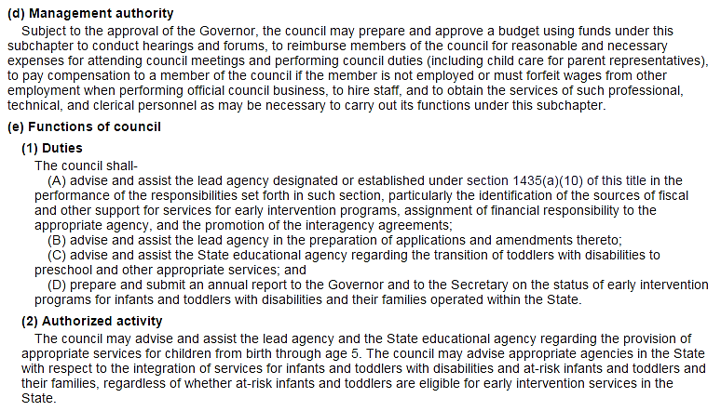
United States Code (USC)
Notes:
The United States Code (USC) contains information about the state interagency coordinating council (ICC). In Texas, we refer to the ICC as the Advisory Committee. The USC provides a general overview of the roles and responsibilities of Advisory Committee members. This link will take you directly to the information listed above:
http://uscode.house.gov/view.xhtml?req=(title:20%20section:1441%20edition:prelim)%20OR%20(granuleid:USC-prelim-title20-section1441)&f=treesort&edition=prelim&num=0&jumpTo=true

Slide 9
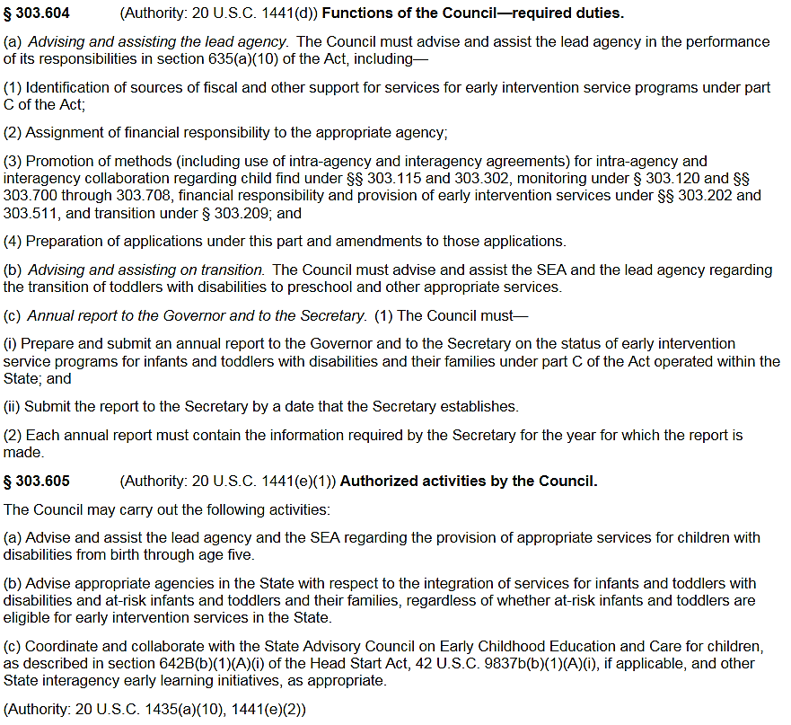
Code of Federal Regulations (CFR)
Notes:
The Code of Federal Regulations (CFR) provides more in-depth information about your role as an Advisory Committee member. As part of §303.604 (a), ECI will ask you, as an Advisory Committee member, to review and provide input and guidance on proposed rules. Rules in the Texas Administrative Code (TAC) serve as an important part of Texas ECI policy. The Advisory Committee does not “approve” rules, and ECI is not required to accept changes proposed by the Advisory Committee; however, you represent an important constituency for ECI, so your perspective on proposed changes to the rules is valuable and will be taken into consideration.
As an Advisory Committee member, you can and should ask for a discussion of any current or proposed rule or circumstance that is of concern to you and the group you represent. Similarly, if there is anything that is not addressed in the rule that you believe should be, please bring it to the attention of the Committee and State Office. If you have a particular interest or expertise in a specific ECI topic, let the State Office know, so you can be contacted for additional input outside of regular Committee meetings.
This link will take you directly to the information listed on screen: http://www.ecfr.gov/cgi-bin/text-idx?c=ecfr;sid=65e04594421191528ad86f073961470b;rgn=div5;view=text;node=34%3A2.1.1.1.2;idno=34;cc=ecfr#se34.2.303_1604

Slide 10
What to Expect at Meetings
Meetings typically start at 10 a.m.
Prepared agenda, but order may change
Committee discusses each agenda item
Lunch on your own
ECI state office can assist with travel arrangements and reimbursements
Notes:
The quarterly Advisory Committee meetings typically start at 10 am. There is a prepared agenda that you will receive ahead of time, but some changes in the order may take place depending on availability of members or presenters. By looking over the agenda before the meeting, you can get input from your constituents and come prepared to provide input on topics related to the group you represent. You should also be prepared for lunch on your own. There are a variety of restaurants in close proximity to the HHSC campus.
Dress comfortably. Because room temperatures can vary in meeting rooms, you may want to bring a sweater or jacket in case the room gets chilly.

Slide 11
Travel Reimbursement
ECI Advisory Committee Liaison
512-424-6795
Notes:
ECI has funds available to reimburse committee members for their travel costs. Travel is reimbursed for those members traveling 50 miles or more to attend meetings, in accordance with State and Federal regulations.
Some of the reimbursement items may include:
Refundable airline tickets
Rental car and the cost for gas or personal car mileage
Parking charges, either at the airport, hotel or meeting location
Overnight lodging with a State Contracted hotel at a rate set by the US General Services Administration (GSA)
Additionally, meals for those members on travel status are reimbursed for the amount spent, up to a maximum set by the State Comptroller.
There are specific rules that govern travel reimbursement. The ECI Advisory Committee Liaison will work with each member to secure travel in accordance with the travel policies.
If you need help with travel arrangements or have any questions, ECI state office staff are available to help. Please contact the ECI Advisory Committee Liaison at 512-424-6795.

Slide 12
Who’s On the Committee?
Maximum of 25 members
Appointed by the Governor
Staggered 6-year terms
Notes:
You might be wondering who else is on the committee and who they represent. State rule indicates that the Advisory Committee can be made up of no more than 25 members, each of whom is appointed by the Governor for a 6-year term. The terms are staggered so that the terms of 8 members end and 8 new members begin serving on February 1 of every odd-numbered year.
In addition to the 25 “official” members, up to 6 ex-officio members may be appointed for specific, time-limited tasks if needed by the committee.

Slide 13
Composition of the Committee
Required representation from:
Parents
Early Intervention service providers
Texas Legislature
Personnel preparation
State agency responsible for
Early Intervention
Regulating health insurance
Child care
Head Start
Notes:
To ensure that the committee is informed by a variety of perspectives, representation by different groups involved with or interested in services to young children with disabilities is required by state and federal law. At least seven of the committee members must be parents, including parents of children with disabilities, and parents representing minority populations. Five of the committee members must be public or private providers of early intervention services. In addition, one member must also be a member of the Texas Legislature and one member must be involved in personnel preparation, which is the education and training of early intervention staff.
Representation is also required from a state agency that either provides or pays for early intervention services. The Advisory Committee must also have members representing the state agency responsible for regulating health insurance and a state agency responsible for child care. A representative from a Head Start agency or program is also required on the Advisory Committee.

Slide 14
Composition of the Committee
Required representation from:
Organization serving homeless children
State Medicaid agency
State Education agency
Foster care agency
Mental health agency
Education Service Center
Advocate for children with disabilities
Physician
Notes:
Other groups that must be represented on the committee include an organization serving homeless children, the state Medicaid agency (in Texas, this is the Health and Human Services Commission), the state Education agency (in Texas, the Texas Education Agency, or TEA), and a foster care agency. In addition, there must also be Advisory Committee Members representing a mental health agency and an Education Service Center. Finally, at least one member of the Advisory Committee must be an advocate for children with disabilities and one member must be a physician.

Slide 15
State Resources
Online from the Office of the Attorney General
Provide a copy of training completion to ECI AC Liaison
Open Meetings Act Training Video
Notes:
In addition to IDEA, the Texas Administrative Code (TAC) and the Advisory Committee’s bylaws, there are numerous other resources at your disposal to help you learn more about ECI and your role on the Advisory Committee.
All members of the ECI Advisory Committee are required by state law to receive training through the Office of the Attorney General on the requirements of the Texas Open Meetings Act. The training is available online and can be found by clicking the link titled “Open Meetings Act Training Video.” (https://www.texasattorneygeneral.gov/media/videos/play.php?image=2005openmeetings&id=149) Once you have completed the training video, print your completion certificate and provide a copy to the ECI Advisory Committee Liaison for documentation purposes.

Slide 16
State Office Sections
Leadership
Handling of complaints and strategic planning
Performance and Oversight
Management of funding streams, monitoring of contractors, and administration of ECI data systems.
Program Evaluation, Analysis and Reporting
Policy and data analysis, development of Annual Performance Report, and management of web-based applications.
Policy and Support
Development of rules and standards, public outreach initiatives, and training for personnel development.
Notes:
In addition to providing leadership, handling complaints from consumers, and strategic planning initiatives, the Division of Early Childhood Intervention Services has three distinct sections:
The Performance and Oversight section is responsible for assessment and oversight of the ECI service delivery system. This includes management and oversight of revenue and expenditure funding streams, monitoring of contractor performance and compliance, and administration of ECI data systems to support program activities.
The Program Evaluation, Analysis, and Reporting section is responsible for providing data analysis and evaluation, including the development of the federal Annual Performance Report and managing all ECI web based applications.
The Policy and Support section is responsible for providing information, support and technical assistance to local ECI contractors. This includes development of rules and standards, public outreach initiatives, and managing a comprehensive system of personnel development.

Slide 17
ECI’s relationship with OSEP
Office of Special Education Programs (OSEP):
Reviews and approves ECI’s grant application
Provides oversight to ensure adherence to regulations
Review Annual Performance Report (APR)
Reviews state rules
Onsite monitoring
Provides technical assistance - ECTA Center
Reviews how Texas utilizes its Interagency Coordinating Council (ICC)
Notes:
In addition to relationships with local contractors, ECI also has an important relationship with the Office of Special Education Programs (or OSEP). Each year, ECI applies for an OSEP grant to provide ECI services in Texas. OSEP reviews the grant and makes a decision about whether to approve the grant. Once the grant is approved, OSEP provides oversight to ensure ECI is adhering to the requirements of the grant and IDEA. This oversight includes reviewing the Annual Performance Report (or APR) which shows how Part C in Texas is performing based on established targets.
OSEP looks at how states are using their Interagency Coordinating Council (ICCs). OSEP also reviews the chapter of the Texas Administrative Code that applies to ECI to ensure it meets the requirements set forth in IDEA and the Code of Federal Regulations (CFR). Just as ECI does onsite monitoring of contractors to ensure compliance with their ECI contract, OSEP makes periodic onsite visits to ECI to provide oversight. Finally, OSEP provides technical assistance to state ECI agencies through the Early Childhood Technical Assistance Center, or ECTA Center (http://ectacenter.org/).

Slide 18
ECI By the Numbers
Contractors serving every county
53,077 infants and toddlers served in FY 2016
Notes:
The ECI State Office contracts with agencies to provide services in every county in Texas. During fiscal year 2016, more than 50,000 children and families received comprehensive early intervention services.
Agencies include community centers, school districts, education service centers, and private nonprofit organizations. Local program directors and staff providing services directly to families are not employees of HHSC. They are employed by the local contracting agencies. ECI provides oversight through performance and contract management.
Each ECI contractor is monitored on-site at least once every three years. The monitoring schedule is determined each year based on a risk assessment completed by Contract Oversight and Support. Programs that have a higher risk level are monitored more frequently. In addition to performance and contract management, the ECI state office also provides training and technical assistance on implementing requirements and providing quality services to ECI contractors and their staff.

Slide 19
About Texas ECI
Notes:
In this video, you’ll hear from families who have received ECI services. (https://youtu.be/vA5hiIYj5eQ)

Slide 20
Individualized Service Delivery
Service Types:
Services are individualized to meet each family’s unique needs. Based on specific needs, services can include the following:
Assistive Technology
Behavioral Intervention
Case Management
Counseling
Family Education and Training
Nursing Services
Nutrition Services
Occupational Therapy
Physical Therapy
Psychological Services
Social Work
Specialized Skills Training
Speech/Language Therapy
Watch an example of a service delivery visit.
Notes:
ECI can provide a wide variety of services to address. The services a child receives are individualized to meet the specific needs of the child’s family. Services are provided in the child’s natural environment. The specific location is planned during the Individualized Family Service Plan, or IFSP meeting. ECI staff focus intervention on caregivers' ability to promote the child's participation in naturally occurring, everyday routines and developmentally appropriate activities.
Throughout a service delivery visit, the provider is observing:
the child/caregiver engagement in a typical activity,
what skills the child is using, and
if necessary, intentionally modeling to the caregiver how to support the child’s participation within that activity.
The provider suggests strategies for the caregiver to try and will ask the caregiver to demonstrate the activity by verbally prompting or directly teaching the caregiver to support his/her success. Throughout action and practice, the provider gives feedback affirming the actions and evaluating caregiver efforts, which help to build the caregiver’s confidence in doing the activities. Families and providers reflect on various activities throughout the visit to find out what the family already knows, to analyze responses to activity implementation, to generate new ideas, and to create a new joint plan. The visit is a collaborative process designed to build the caregiver’s confidence and competence in supporting the child’s development. View the video for an example of a service delivery visit. The video is a minute and a half long. (http://www.youtube.com/watch?v=fZ0rUBxYcJw)

Slide 21
Family-Centered Services
Family-guided team approach
Array of services
Specialized Skills Training
Case Management
Natural environment
Coaching
Notes:
While eligibility is determined based on the child, the family receives the services. Every family has a team. Teams consist of the family, a service coordinator, and any additional professionals needed to assist in meeting the child’s outcomes. Again, the outcomes are based on the child and family needs.
Another important service ECI provides is case management. All children enrolled in ECI have a service coordinator who provides case management. Service coordinators are responsible for assisting families in accessing resources, ensuring families are aware of their rights, and coordinating services. Services occur in the child’s natural environment.

Slide 22
Notes:
Research shows that infants and toddlers learn best through everyday experiences and interactions with familiar people in familiar contexts. Service providers go wherever the family goes and where intervention is needed. This is not limited to the child’s house or childcare center. A natural environment is anywhere typically developing children live, learn, and play in the community. Services could be provided in a grocery store, at a restaurant, in the mall, or at a playground. The various settings range from going to meet a family living in their car under a bridge to homes of wealthy businesspeople.

Slide 23
Questions?
Contact:
ECI Advisory Committee Outreach Specialist listed in your manual
ECI state office: 512-424-6754
Notes:
If you have any questions, please contact the ECI Advisory Committee Outreach Specialist listed in your Advisory Committee member manual section 4 under the Policy and Support Section. You may also contact the ECI State office at 512-424-6754.
In the next module, you will learn about the history, laws, legislation, and rules that govern ECI services.

